Slide 1
Software Development 2
Java GUI Fundamentals
F27SB

Slide 2
Last Lecture
Why it is important to design an interface
Why you should always consider the user
Form follows function
Maintaining the user illusion
Separating implementation from interface

Slide 3
TODAY’S LECTURE

Slide 4
Today
Introduction to implementing GUIs in Java
How to create windows
Responding to user interaction

Slide 5

Overview
Java GUIs are based on 3 main class libraries:
AWT - Abstract Windowing Toolkit
The original Java GUI classes
Swing
The current standard, and the focus of this course
Extends AWT classes
JavaFX
Better support for animation and media content
Not covered in this course

Slide 6

Wider Reading
The Swing tutorial
http://docs.oracle.com/javase/tutorial/uiswing/
Introduction to Programming Using Java
http://math.hws.edu/javanotes/
Free online book with a good introduction to Swing
The Guide Book
http://www.macs.hw.ac.uk/cs/java-swing- guidebook/

Slide 7

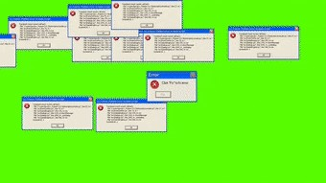
Pronounced: “goo-ee"
GUI

Slide 8
Inheritance in the GUI libraries
Inheritance is widely used in AWT and Swing:
Component
AWT
class
Swing class
 | exten
Container
ds
extends
Window
JComponent
extends
extends
Frame
Dialog
JLabel
JPanel
AbstractButton
 | ext
JFrame
ends
extends
JButton
JMenuItem

Slide 9
AWT
import java.awt.*;
java.awt contains the AWT GUI classes
Component
main AWT class of GUI elements
extended by Label, Button, TextField

Slide 10
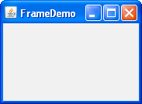
Container
class of Components that can have other
Components inside them
e.g. Frame
top-level displayable window
e.g. Panel
Container with no display
LayoutManager
interface class
controls positions of nested Components

Slide 11
Container methods
all Containers have rectangular size
public void setSize(int width, int height)
specified by the smallest enclosing rectangle
width and height are in pixels
pixel = one point on the screen

Slide 12


Container methods
size of pixel depends on
screen’s physical size
diagonal in inches e.g. 15”; 17”; 21”
screen resolution
number of columns/rows in pixels
e.g. HD 1920*1080, 4K 3840x2160, 8K 7680x4320
make sure Container is big enough to hold everything!
size of Container will change depending on properties of LayoutManager – more later

Slide 13

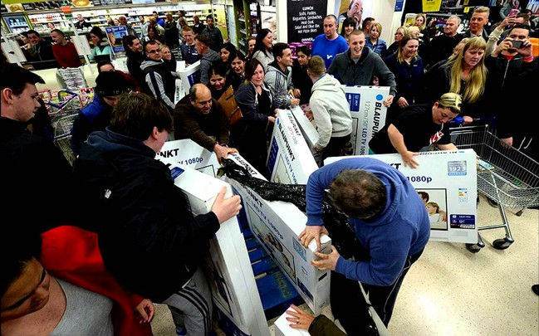
Container methods
• size of pixel depends on
– screen’s physical size
• diagonal in inches e.g. 15”; 17”; 21”
– screen resolution
• number of columns/rows in pixels
e.g. HD 1920*1080, 4K 3840x2160, 8K 7680x4320
• make sure Container is big enough to hold everything!
• size of Container will change depending on properties of LayoutManager – more later

Slide 14
Container methods
Containers may be visible or invisible
public void setVisible(boolean b)
make visible
setVisible(true)
make invisible
setVisible(false)
use to change Component availability
– e.g. turn available buttons on/off

Slide 15
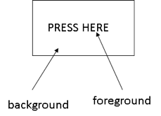
Container methods
Containers have:
background
what things are drawn on e.g. paper
foreground
what things are drawn in e.g. pen
e.g. Label

Slide 16
Container methods
public void setBackground(Color c)
set Container’s background colour to c
public void setForeground(Color c)
set Container’s foreground colour to c
use these to change foreground/ background dynamically at run-time

Slide 17

Container methods
public class Color public static final Color
black, blue, cyan, darkGray, gray, green lightGray, magenta, orange, pink, red, white, yellow
Note that this class is static
must preface colour identifier with Color.
e.g. setForeground(Color.blue)

Slide 18


Basic Swing classes
import javax.swing.*;
javax.swing contains the Swing GUI classes
public class JComponent extends Container
main Swing GUI class

Slide 19



Basic Swing classes
import javax.swing.*;
javax.swing contains the Swing GUI classes
public class JComponent extends Container
main Swing GUI class
Swing components often begin with a ‘J’. In general these should be used instead of AWT components.
e.g. use JLabel, not Label

Slide 20


Basic Swing classes
import javax.swing.*;
javax.swing contains the Swing GUI classes
public class JComponent extends Container
main Swing GUI class
This is not quite logical since many JComponents (e.g. buttons, labels) cannot sensibly contain other components!

Slide 21


Frames
public class JFrame extends Frame
top-level window
may have title-bar, menu-bar, cursor, icon, etc.
NB: not a JComponent
public void setTitle(String title)
set title on Frame’s title bar to title

Slide 22

Frames
To create and display an empty JFrame:
import javax.swing.*; public class JavaGUI {
public static void main(String[] args) {
JFrame frame = new JFrame(); frame.setSize(800,400); frame.setTitle("Java GUI demo"); frame.setVisible(true);
}
}

Slide 23
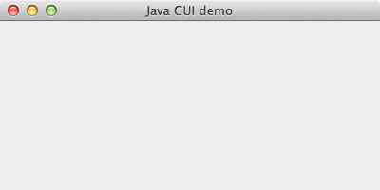
Frames

Slide 24

ContentPane
In general, cannot work directly on
JFrame
must manipulate the JFrame’s ContentPane
ContentPane is a Container
has BorderLayout as default
more on this later
to access ContentPane use:
public Container getContentPane()

Slide 25

ContentPane
To create and display a black empty
JFrame:
import javax.swing.*; import java.awt.Color;
public class JavaGUI {
public static void main(String[] args) { JFrame frame = new JFrame(); frame.setSize(800,400); frame.setTitle("Java GUI demo"); frame.getContentPane().
setBackground(Color.BLACK); frame.setVisible(true);
}
}

Slide 26
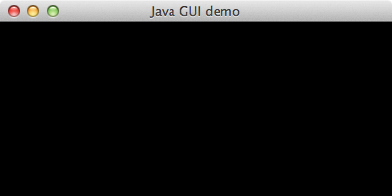
ContentPane

Slide 27

ContentPane
Too much happening in main() – bad design!
import javax.swing.*; import java.awt.Color;
public class JavaGUI {
public static void main(String[] args) { JFrame frame = new JFrame(); frame.setSize(800,400); frame.setTitle("Java GUI demo"); frame.getContentPane().
setBackground(Color.BLACK); frame.setVisible(true);
}
}

Slide 28


Better Style
public class BlackFrame extends JFrame { public BlackFrame() {
this.getContentPane(). setBackground(Color.BLACK);
}
}
public class JavaGUI {
public static void main(String[] args) { BlackFrame frame = new BlackFrame(); frame.setSize(800,400); frame.setTitle("Java GUI demo"); frame.setVisible(true);
}
}
Notes:
Keep the global things like size , title which you need global .so client can create a customized frame.

Slide 29

Better Style
public class class-name extends JFrame { public class-name() {
//perform initialisation
//add contents to the frame
}
}
public class program-name {
public static void main(String[] args) { class-name frame = new class-name();
//address global concerns
//such as size and location of GUI
}
}

Slide 30
Caveats
Remember to leave room for the title bar when setting a frame’s size
e.g. add extra 20 pixels to height
Some JFrame methods will work implicitly on its ContentPane
e.g. add(…), setLayout(…)
So you do not always need to call
getContentPane()

Slide 31
EVENTS AND LISTENERS

Slide 32


Events and listeners
What happens when someone presses this?
event
something that happens outside of a program
often as a result of a user interacting with its GUI
listener
code that responds to an event

Slide 33
Events and listeners
Selecting title bar icons causes events
Events are detected by the Java system
Java system:
stops our program
calls the appropriate listener

Slide 34


Events and listeners
For this to happen, we need to...
import AWT Java event classes
import java.awt.event.*;
tell Java we have a listener for window events, using the JFrame method:
public void
addWindowListener(WindowListener l)
build a WindowListener to respond to events

Slide 35
Events and listeners
interface WindowListener
Provides a framework for building a
WindowListener
abstract method for each event to be handled
no method body

Slide 36

Events and listeners
public interface WindowListener extends EventListener
{
public void windowActivated(WindowEvent e); public void windowClosed(WindowEvent e); public void windowClosing(WindowEvent e); public void windowDeactivated(WindowEvent e); public void windowDeiconified(WindowEvent e); public void windowIconified(WindowEvent e); public void windowOpened(WindowEvent e);
}

Slide 37
Events and listeners
specific events when window is:
activated/deactivated
opened/closed
iconified/deiconified
system:
calls the appropriate method from interface
provides a WindowEvent parameter to provide details of the event

Slide 38
Events and listeners
all methods in WindowListener are abstract
our class must
implement WindowListener
provide details for all methods
we could implement details of all the interface methods ourselves...

Slide 39

Events and listeners
but easier (and more concise) to:
subclass a supplied implementation of the interface
override methods we are concerned about
public class WindowAdapter
implements WindowListener
provides empty versions of all above methods
so subclass WindowAdapter and only override the methods that should do something

Slide 40

Example
import java.awt.event.*;
class MyFrameListener extends WindowAdapter { public void windowClosing(WindowEvent e) {
System.exit(0);
}
}
public class JavaGUI {
public static void main(String[] args) { BlackFrame frame = new BlackFrame();
...
frame.addWindowListener(new
MyFrameListener());
}
}

Slide 41

Alternatively
import java.awt.event.*;
public class JavaGUI {
public static void main(String[] args) { BlackFrame frame = new BlackFrame();
… frame.addWindowListener(
new WindowAdapter(){
public void windowClosing(WindowEvent e){ System.exit(0);
}
});
}
}

Slide 42




Alternatively
import java.awt.event.*;
public class JavaGUI {
public static void main(String[] args) { BlackFrame frame = new BlackFrame();
… frame.addWindowListener(
new WindowAdapter(){
public void windowClosing(WindowEvent e){ System.exit(0);
}
});
}
}
This is an ‘anonymous class’, a way of reducing code when you only need to create a single
instance of a class – it is commonly used to create event listeners.

Slide 43
Example: flashing window
Window flashes black to white and back every 0.5 sec
repeatedly change background
need some way of pausing
import java.util.*;
Calendar class
Calendar Calendar.getInstance()
returns a Calendar object which holds a snapshot of the current date and time

Slide 44
Example: flashing window
long getTimeInMillis()
returns time in milliseconds from Calendar
object
NB to update time, must create new
Calendar object
to pause:
find start time
and then repeatedly
compare current time with start time
until required time has passed

Slide 45

Example: flashing window
void pause(long millisecs) { long startTime =
Calendar.getInstance(). getTimeInMillis();
while(Calendar.getInstance().
getTimeInMillis()- startTime < millisecs);
}

Slide 46
Example: flashing window
import java.awt.*; import java.awt.event.*; import javax.swing.*; import java.util.*;
class Blackwhite extends JFrame
{ public Blackwhite()
{ getContentPane(). setBackground(Color.black); }
private void pause(long millisecs){...}

Slide 47
Example: flashing window
public void flash()
{ while(true)
{ pause(500); getContentPane().
setBackground(Color.white); pause(500); getContentPane().
setBackground(Color.black);
}
}
}

Slide 48
Example: flashing window
class TestBlackwhite
{ public static void main(String [] args)
{ Blackwhite b;
b = new Blackwhite(); b.setTitle(“Black and white”); b.setSize(200,220); b.setVisible(true);

Slide 49

Example: flashing window
b.addWindowListener (new WindowAdapter()
{ public void windowClosing (WindowEvent e)
{ System.exit(0); }
});
b.flash();
}
}

Slide 50
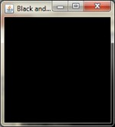
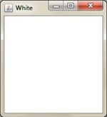
Example: flashing window

Slide 51
THAT’S IT

